Slide 1

Computational Structures in Data Science
UC Berkeley EECS Adj. Ass. Prof. Gerald Friedland
Lecture #18: Efficiency
April 3rd, 2020
http://inst.eecs.berkeley.edu/~cs88

Slide 2
Solutions for the Wandering Mind
Can you write a quine that mutates on self-replication?
Yes!
Give an example.
A Fibonacci-quine outputs a modification of the source by the following rules:
1) The initial source should contain 2.
2) When run, output the source, but only the specific number
(here 2) changed to the next number of the Fibonacci sequence. For example, 3. Same goes for the output, and the output of the output, etc.
s='s=%r;print(s%%(s,round(%s*(1+5**.5)/2)))';print(s%(s,round(2*(1+5**.5)/2)))

Slide 3
Why?
Runtime Analysis:
How long will my program take to run?
Why can’t we just use a clock?
Data Structures
OOP helps us organize our programs
Data Structures help us organize our data!
You already know lists and dictionaries!
We’ll see two new ones today
Enjoy this stuff? Take 61B!
Find it challenging? Don’t worry! It’s a different way of thinking.

Slide 4
Efficiency
How long is this code going to take to run?

Slide 5
Is this code fast?
Most code doesn’t really need to be fast! Computers, even your phones are already amazingly fast!
Sometimes…it does matter!
Lots of data
Small hardware
Complex processes
We can’t just use a clock
Every computer is different? What’s the benchmark?

Slide 6
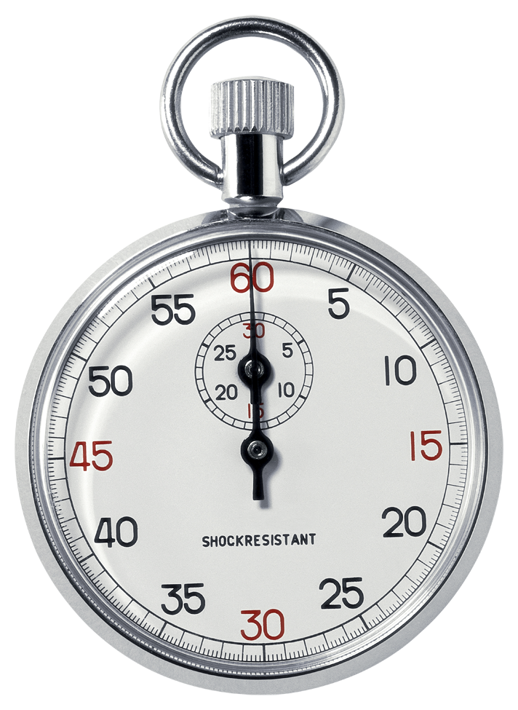
Runtime analysis problem & solution
Time w/stopwatch, but…
Different computers may have different runtimes. ☹
Same computer may have different runtime on the same input. ☹
Need to implement the algorithm first to run it. ☹
Solution: Count the number of “steps” involved, not time!
Each operation = 1 step
If we say “running time”, we’ll mean # of steps, not time!

Slide 7
Runtime: input size & efficiency
Definition
Input size: the # of things in the input.
E.g., # of things in a list
Running time as a function of input size
Measures efficiency
Important!
In CS88 we won’t care about the efficiency of your solutions!
…in CS61B we will
CS88
CS61B
CS61C

Slide 8
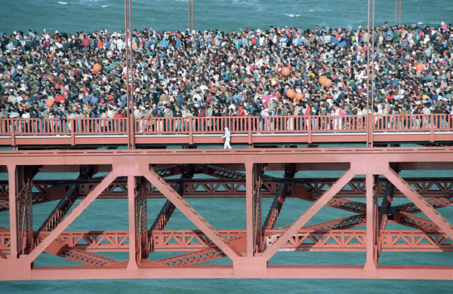
Runtime analysis : worst or avg case?
Could use avg case
Average running time over a vast # of inputs
Instead: use worst case
Consider running time as input grows
Why?
Nice to know most time we’d ever spend
Worst case happens often
Avg is often ~ worst
Often called “Big O”
We use ”Omega” denote runtime

Slide 9
Runtime analysis: Final abstraction
Instead of an exact number of operations we’ll use abstraction
Want order of growth, or dominant term
In CS88 we’ll consider
Constant
Logarithmic
Linear
Quadratic
Exponential
E.g. 10 n² + 4 log n + n
…is quadratic
Exponential
Cubic
Quadratic
Linear
Logarithmic
Constant
Graph of order of growth curves on log-log plot

Slide 10

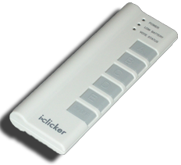
Example: Finding a student (by ID)
Input
Unsorted list of students L
Find student S
Output
True if S is in L, else False
Pseudocode Algorithm
Go through one by one, checking for match.
If match, true
If exhausted L and didn’t find S, false
Worst-case running time as function of the size of L?
Constant
Logarithmic
Linear
Quadratic
Exponential

Slide 11
Example: Finding a student (by ID)
Input
Sorted list of students L
Find student S
Output : same
Pseudocode Algorithm
Start in middle
If match, report true
If exhausted, throw away half of L and check again in the middle of remaining part of L
If nobody left, report false
Worst-case running time as function of the size of L?
Constant
Logarithmic
Linear
Quadratic
Exponential

Slide 12
Computational Patterns
If the number of steps to solve a problem is always the same → Constant time: O(1)
If the number of steps increases similarly for each larger input → Linear Time: O(n)
Most commonly: for each item
If the number of steps increases by some a factor of the input → Quadradic Time: O(n²)
Most commonly: Nested for Loops
Two harder cases:
Logarithmic Time: O(log n)
We can double our input with only one more level of work
Dividing data in “half” (or thirds, etc)
Exponential Time: O(2^{n})
For each bigger input we have 2x the amount of work!
Certain forms of Tree Recursion

Slide 13
Comparing Fibonacci
def iter_fib(n):
x, y = 0, 1
for _ in range(n):
x, y = y, x+y
return x
def fib(n): # Recursive
if n < 2:
return n
return fib(n - 1) + fib(n - 2)

Slide 14
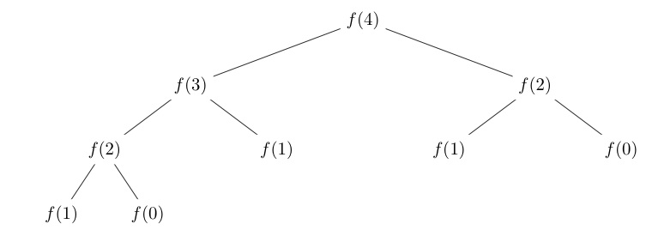
Tree Recursion
Fib(4) → 9 Calls
Fib(5) → 16 Calls
Fib(6) → 26 Calls
Fib(7) → 43 Calls
Fib(20) →

Slide 15
What next?
Understanding algorithmic complexity helps us know whether something is possible to solve.
Gives us a formal reason for understanding why a program might be slow
This is only the beginning:
We’ve only talked about time complexity, but there is space complexity.
In other words: How much memory does my program require?
Often times you can trade time for space and vice-versa
Tools like “caching” and “memorization” do this.
If you think this is cool take CS61B!

Slide 16
Thoughts for the Wandering Mind
Consider the following simple Python code:
x = input("Enter a number between 0 and 1:")
for i in range(10):
x=-x**2+4*x
print x
Plot the function implemented by the code.
Could you predict using sampling (e.g., interpolate from the results of inputs 0, 0.25, 0.5, 0.75, 1)?
Could you predict using calculus (e.g., using the derivative of f(x)=-x²+4x)?
Could a neural network learn the function, given enough (input, output) tuples as training data?

